Slide 1


COMMUNICATION TOOLKIT
Understanding the Illicit Alcohol Market in South Africa
For Member and Stakeholder Amplification June 2025

Slide 2

Objective of This Toolkit
This toolkit has been developed to support DF-SA members and stakeholders in amplifying the findings and strategic messaging from the 2025 national study on illicit alcohol: Understanding the Illicit Alcohol Market in South Africa, commissioned by the Drinks Federation of South Africa (DF-SA) and conducted by Euromonitor International. The objectives are to:
Raise awareness of the scale and impact of illicit alcohol in South Africa.
Equip members with ready-to-use materials for consistent and impactful messaging.

Slide 3
How to Use the Campaign Elements
Stakeholders are encouraged to use the provided campaign assets across a variety of platforms, including:
LinkedIn and other professional networks
Company newsletters and internal communications
Industry events, trade media, and partner briefings
Staff and stakeholder updates

Slide 4
Guidelines for Use: - Maintain alignment with key findings and DF-SA messaging. - Always reference the full study name — Understanding the Illicit Alcohol Market in South Africa — and credit Euromonitor International as the research partner. - Tag @Drinks Federation of South Africa in social media posts and use the campaign hashtags below. - Use the DF-SA pledge badge to publicly demonstrate your commitment to responsible trade. - Feel free to adapt content to suit your tone, but ensure facts and source references remain intact.

Slide 5
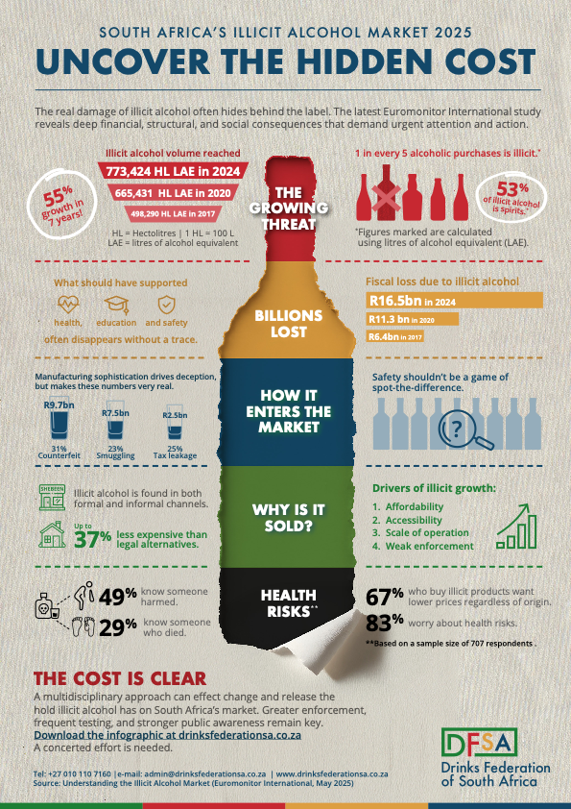
Campaign Elements Included
Infographic - A single-page visual summary of the key findings from the study. - Designed for use in social posts, presentations, and newsletters. - → Attached separately as: “Illicit Alcohol Infographic – DFSA 2025”
Click to download

Slide 6
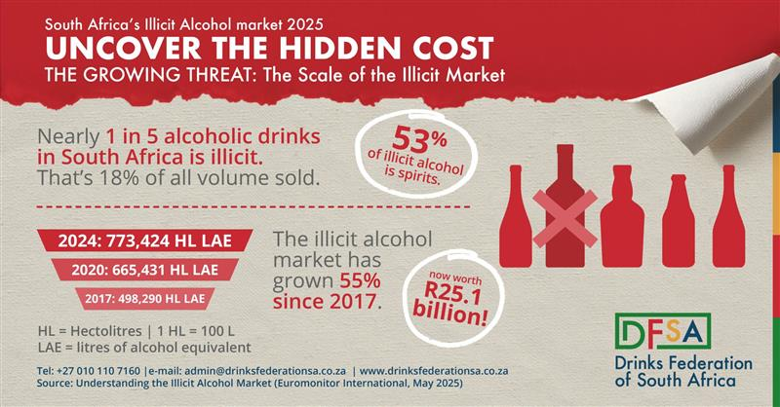
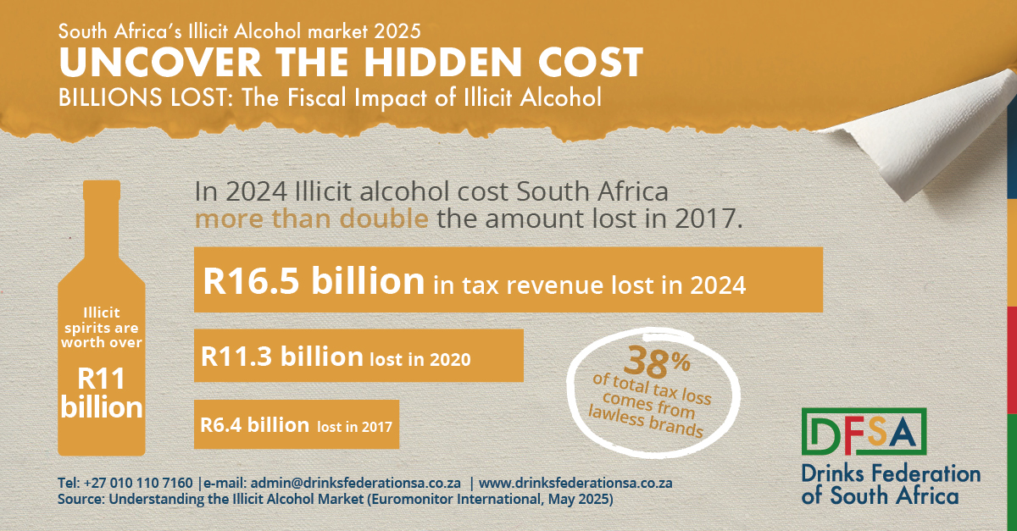
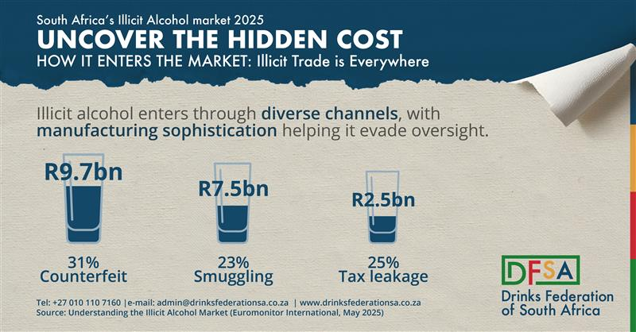
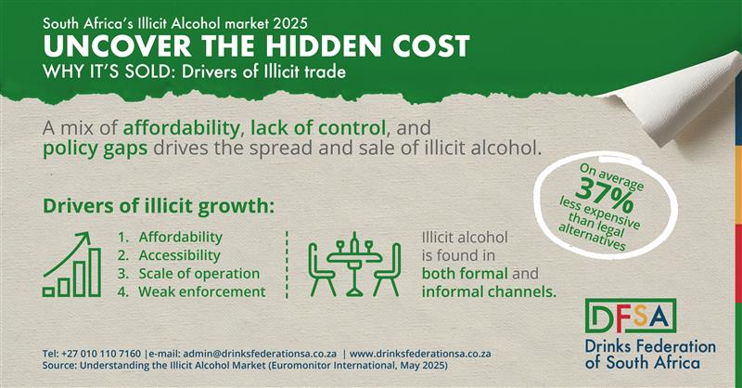
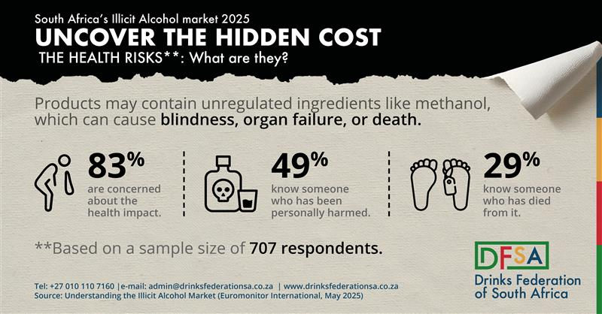
Social Media Tiles
Click to download

Slide 7
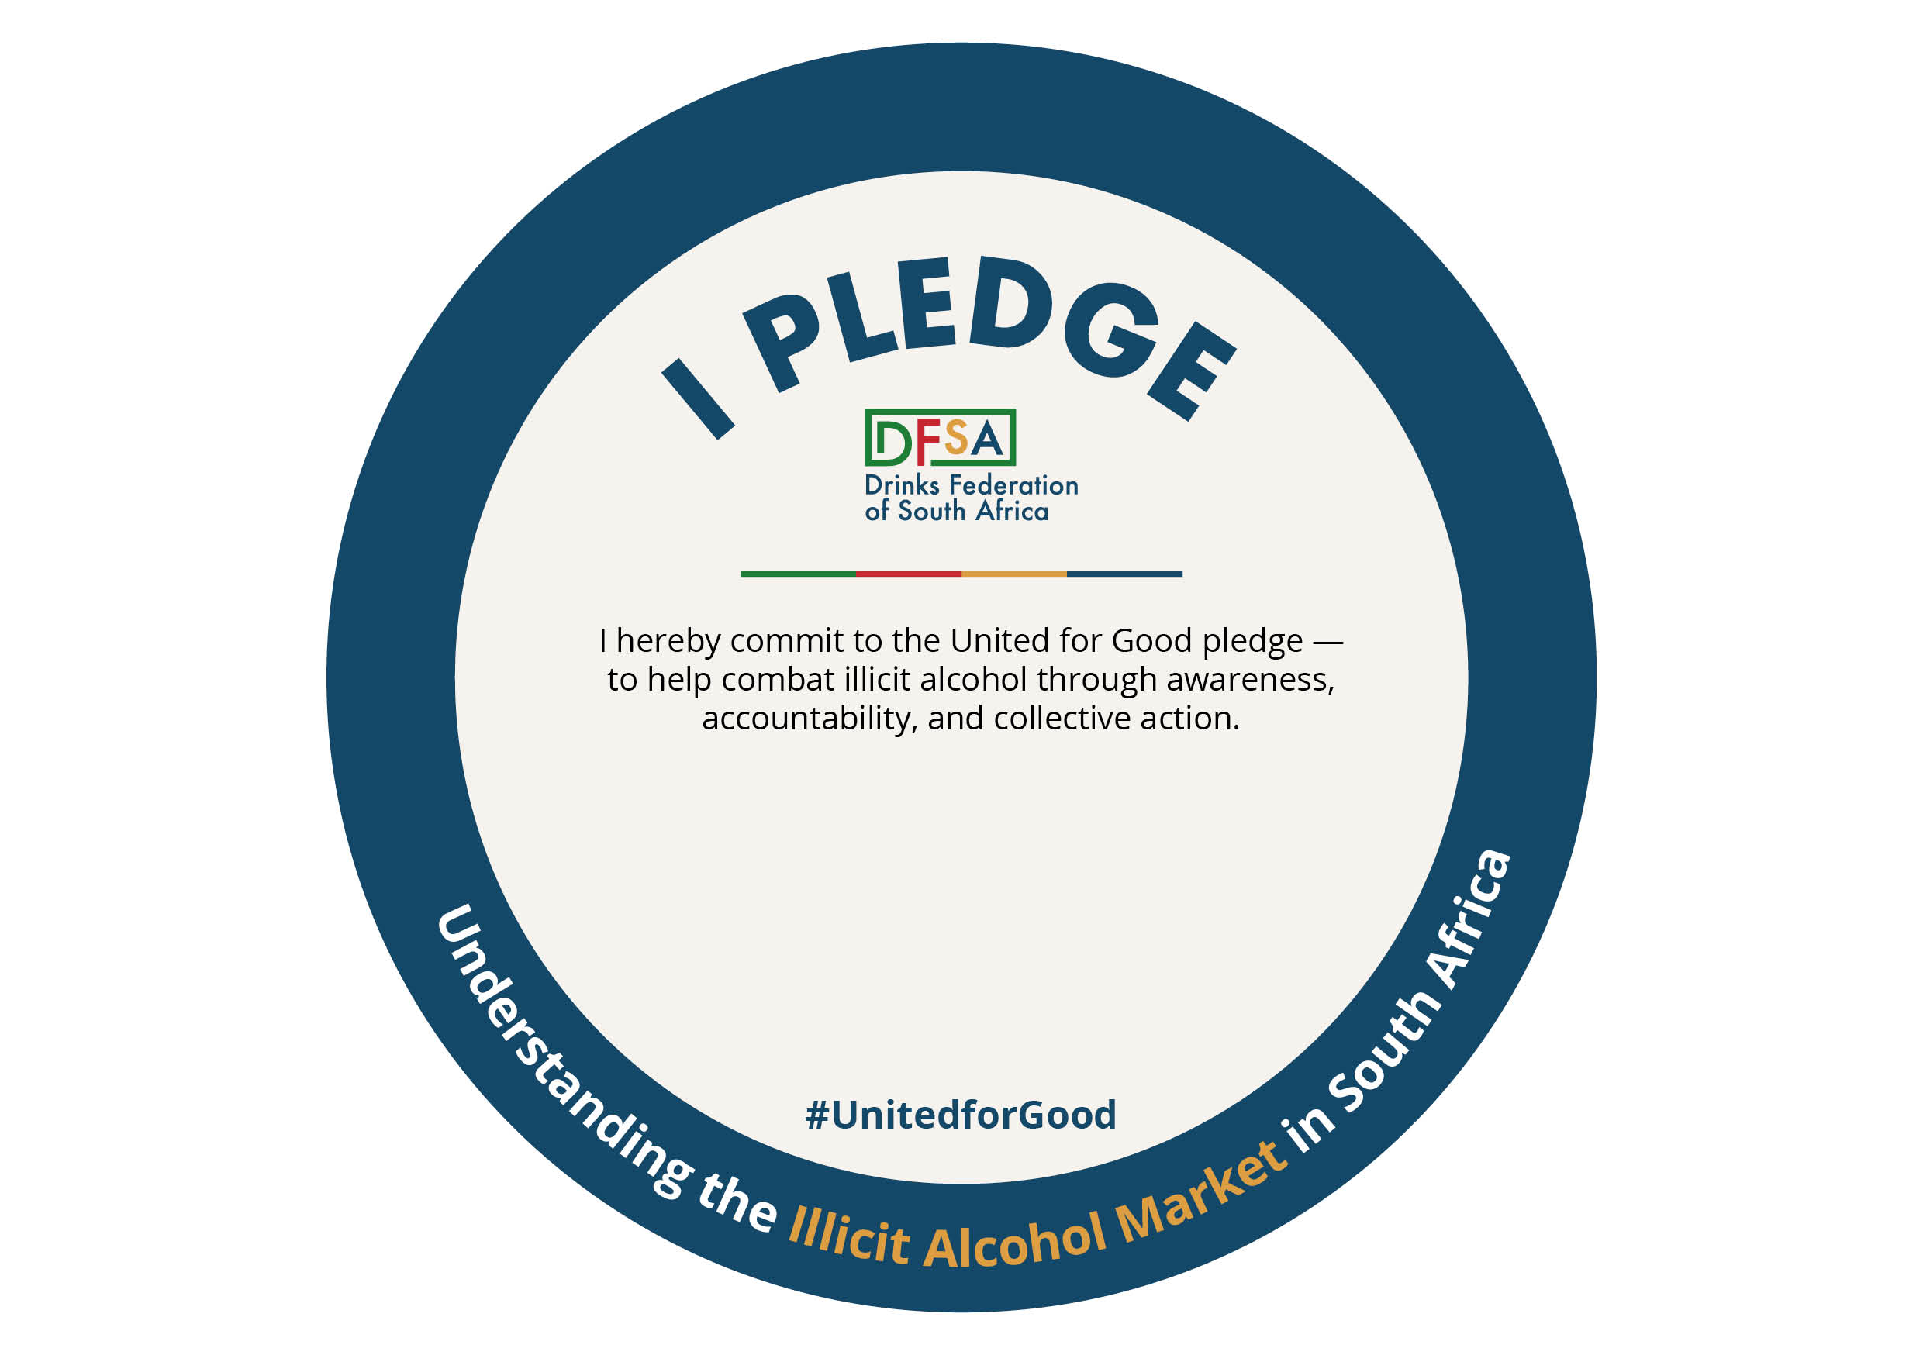
DF-SA Pledge Badge
Click to download
Click to download
PDF FILE AND JPG

Slide 8

DF-SA Logo Pack
Click to download

Slide 9
Pledge to Amplify Integrity
We call on all responsible alcohol industry stakeholders to stand together against illicit trade. Pledge Statement: "We stand for a fair, safe, and responsible alcohol industry. We support research-driven action, public-private solutions, and a unified voice to combat illicit alcohol. We pledge to amplify this message — for industry sustainability and public safety."
How to Display Your Commitment
Use the Pledge Badge on your LinkedIn profile or company website - Add it to your email signature or press releases - Share your support using the suggested caption: "Proud to support the DF-SA pledge for a fair and compliant alcohol industry. Let’s act on the insights from Understanding the Illicit Alcohol Market in South Africa, the 2025 study by DF-SA and Euromonitor International.”
#IllicitAlcoholStudy2025 #StandAgainstIllicit #DFSA #ResponsibleTrade #UnitedForGood

Slide 10

Sample LinkedIn Caption (Infographic)
Today we share key findings from Understanding the Illicit Alcohol Market in South Africa — a national study commissioned by DF-SA and conducted by Euromonitor International. Nearly 1 in 5 alcohol products in South Africa is illicit. The annual cost? Over R16.5 billion in lost tax revenue, and an untold human toll in health, safety, and livelihoods. See the full infographic for more — and let’s #StandAgainstIllicit together. #IllicitAlcoholStudy2025 #DFSA #ConsumerProtection #ResponsibleTrade #UnitedForGood

Slide 11

Campaign Hashtags
Use these consistently to align with the national amplification campaign: #IllicitAlcoholStudy2025 #DFSA #StandAgainstIllicit #ResponsibleTrade #ConsumerProtection #UnitedForGood

